Slide 1
Understanding One Another:
Growing Together in Love, Grace, and Faith
Dr. Joseph Agius
+35679475618
Joseph.agius@hotmail.com

Slide 2
SCHEMATIC MODEL OF
HUMAN BEHAVIOR
UNDERSTANDING ONE ANOTHER
The relationship of the Environmental Press and Human Behaviour applied to Christian marriage

Slide 3
ONCE UPON A TIME…
Notes:
SIMPLE CIRCILE

Slide 4
ATTRACTION
Notes:
Independent circles

Slide 5
STARTING A RELATIONSHIP
FIELD OF RELATIONSHIP
Notes:
TRANSPARENCY
HONESTY
BEING WHO YOU ARE – NOT ACTING

Slide 6
FALLING IN LOVE
FIELD OF RELATIONSHIP
Notes:
COURTING TIME

Slide 7
MARRIAGE
FIELD OF RELATIONSHIP

Slide 8
MARRIAGE GROWS WITH LIFELONG WORK
FIELD OF RELATIONSHIP
Notes:
INDEPENDENT AREA SHOULD BE RESPECTED.
SPOUCES NEED THEIR SPACE
SO, WHAT DOES THE CIRCLE REALY REPRESENT?

Slide 9
Schematic model of human behavior
Notes:
• What it means: The overlapping circles show that our body, thoughts, feelings, and social life work together, with spirituality at their centre. “Environmental Press” means the influences around us that shape behaviour.
• Why it’s included: It gives couples a way to look beyond a partner’s immediate reaction and consider the needs and influences behind it.
• How it fits: Marriage takes lifelong work with later lessons on listening, patience, and self-control. Understanding the whole person helps turn those lessons into daily choices.

Slide 10
Schematic model of human behavior

Slide 11
Schematic model of human behavior

Slide 12
Schematic model of human behavior
Notes:
PROBLEMS CAN AFFECT BEHAVIOUR

Slide 13
Schematic model of human behavior
Notes:
BEHAVIOUR:
Acceptable:
Able to solve problems, not causing marital friction.
Neutral: I don’t care attitude, or I do not mind attitude
Unacceptable:
Causing a negative environment.

Slide 14
Schematic model of human behavior

Slide 15

Schematic model of human behavior
Notes:
Our Testimony????

Slide 16
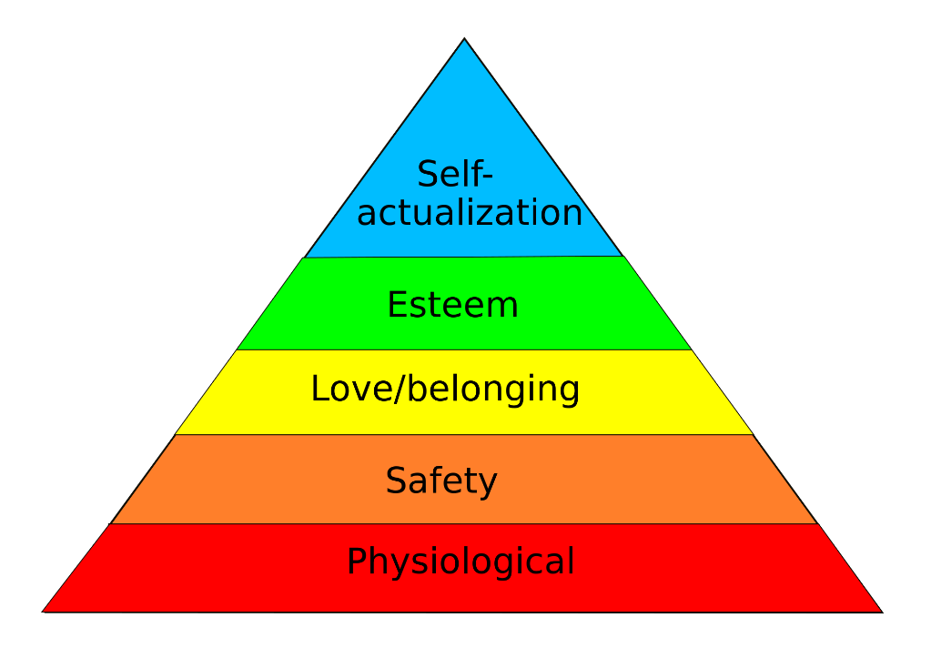
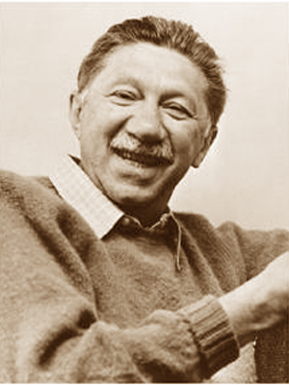
HUMAN’S NATURAL NEEDS FOR PERSONAL FULFILLMENT
Your instructor’s recommendation:
  Abraham Harold Maslow
    Hierarchy of needs
I have come to give you life in its fullness – John 10:10
Seek first the Kingdom of God and His righteousness, and all things shall be added to you – Matt 6:33
Notes:
Physiological Needs — Caring for Each Other
Love includes practical care: food, adequate rest, shared household tasks, and affectionate physical intimacy that respects both spouses’ needs and consent.
Pray for daily provision, then work together to meet those needs. Spiritual nourishment matters alongside physical care. (Matthew 4:4; the Lord’s Prayer)
Safety Needs — Building a Secure Home
Both spouses need to feel physically and emotionally safe.
Build security through
honesty,
faithfulness,
responsible finances, and
keeping promises.
Make room to express concerns without fear or humiliation.
Trust in God should strengthen—not replace—your responsibility to protect and care for one another. (Psalm 46:1)
3. Love and Belonging — Choosing Connection
Marriage needs more than sharing a home; it needs friendship, affection, attentive listening, and time together.
Carry each other’s burdens and stay connected to a supportive Christian community. Let your spouse know: “You matter, and you do not face life alone.” (Acts 2:42–47)
4. Esteem Needs — Honoring Each Other’s Worth
Treat your spouse as someone whose value comes from God,
not income, appearance, or achievements.
Express appreciation, respect their opinions, and recognise their contributions.
Address disagreements without belittling the person.
Your role is to affirm their dignity, not determine their worth. (Psalm 139:14)
5. Purpose and Growth — Helping Each Other Become
Encourage each other’s gifts, calling, and spiritual maturity.
Make shared goals while allowing room for individual growth.
Serve together without expecting identical roles or talents.
A flourishing marriage helps both spouses become who God created them to be. (Ephesians 2:10)
Bottom line: Ask not only, “Are my needs being met?” but also, “How can I help my spouse flourish?”
===============================
1. Physiological Needs: These are still essential—food, water, rest—but Christians are also reminded that “man shall not live by bread alone” (Matthew 4:4). Trusting God for daily provision (like in the Lord’s Prayer: “Give us this day our daily bread”) becomes a spiritual practice.
2. Safety Needs: While physical safety matters, Christians are called to place deeper trust in God’s protection and sovereignty. Psalm 46:1 says, “God is our refuge and strength, an ever-present help in trouble.”
3. Love and Belonging: This aligns beautifully with the Christian call to community. Believers are part of the Body of Christ, called to love one another, bear each other’s burdens, and live in fellowship (Acts 2:42–47).
4. Esteem Needs: Instead of seeking self-worth through status or achievement, Christians find identity in Christ. You are “fearfully and wonderfully made” (Psalm 139:14), and your value comes from being a child of God, not from worldly accolades.
5. Self-Actualization: In Christian terms, this becomes God-actualization—living out your God-given purpose. It’s not just about fulfilling personal potential, but about becoming who God created you to be, using your gifts to serve others and glorify Him (Ephesians 2:10).
+++++++++++++++++++++++++
1. Physiological Needs (Basic survival):
- Food, water, sleep, air, warmth.
- Example: A person eating a meal after being hungry all day.
2. Safety Needs (Security and protection):
- Shelter, personal safety, financial stability, health.
- Example: Someone saving money to afford a home or health insurance.
3. Love and Belongingness Needs (Social relationships):
- Friendships, family bonds, romantic attachments, community.
- Example: Joining a club to make new friends or spending time with loved ones.
4. Esteem Needs (Respect and recognition):
- Self-respect, achievement, status, responsibility.
- Example: Receiving a promotion at work and feeling recognized for hard work.
5. Self-Actualization Needs (Personal growth and fulfillment):
- Pursuing passions, creativity, personal potential.
- Example: An artist devoting time to painting, or someone climbing a mountain to challenge themselves.
Maslow suggested you generally need to satisfy the lower levels before progressing to higher ones—though real life isn’t always that tidy, right?

Slide 17
CHRISTIAN PERSPECTIVES
SEVEN CHARACTERISTICS OF HUMANKIND
God’s Design Genesis 2:18–24; Matthew 19:4–6
Need-Oriented Ephesians 5:28–29
Rational James 1:19–20; Romans 12:2
4. Responsible Ephesians 5:21, 25, 33
5. Moral Hebrews 13:4; Ephesians 4:25
6. Purposive Ephesians 5:25–32
7. Capable of Change Ephesians 4:22–24, 31–32
Notes:
1.God’s Design
2. Need-Oriented
3. Rational
4. Responsible
5. Moral
6. Purposive
7. Capable of Change
Genesis References and Marriage Applications
These seven characteristics form a teaching framework rather than categories explicitly named in Genesis. The following summaries distinguish the passages’ content from applications to marriage.
1. God’s Design — Genesis 1:26–27; 2:24
Both man and woman bear God’s image; marriage joins them as one flesh. Marriage application: Honour each other’s dignity and build unity.
2. Need-Oriented — Genesis 2:18–23
God recognises the man’s need for companionship and provides a suitable partner. Marriage application: Recognise each other’s need for connection, care, and support.
3. Rational — Genesis 2:19–20
Adam names the animals—an illustration of human thought and language, not a direct instruction about marriage. Marriage application: Use your capacity to think, communicate, and make considered decisions together.
4. Responsible — Genesis 2:15
God entrusts Adam with tending and caring for the garden. Marriage application: Apply this principle of stewardship to your home, commitments, and shared responsibilities.
5. Moral — Genesis 2:16–17
God gives a command and explains the consequences of disobedience. Marriage application: Recognise moral boundaries and take responsibility for choices that affect your spouse.
6. Purposive — Genesis 1:28
God gives the man and woman a shared calling involving fruitfulness and stewardship. Marriage application: Build a shared direction for family life, service, and caring for what God entrusts to you.
7. Capable of Change — Genesis 35:1–4
Jacob’s household responds to God’s call by giving up foreign gods. This is a household example, not specifically a marriage teaching. Marriage application: Couples can leave harmful practices behind and take concrete steps towards renewed faithfulness.

Slide 18
INTRODUCTION — A Different Way to See Marriage
When we talk about marriage, we often ask, “How can marriage make me happy?”
  But what if that is the wrong starting point?
  What if God designed marriage not primarily to make us happy, but to make us holy?
  What if marriage is one of God’s most effective tools to shape our character, refine our attitudes, and form Christ in us?
Notes:
Workbook

Slide 19
Agape marriage is the daily choice to:
  love with grace,
  serve with joy, and
  forgive with freedom.
  It is a covenant that transforms us.

Slide 20
Today, we explore how marriage becomes
  a place of spiritual formation —
  a place where the Fruit of the Spirit is not just admired, but exercised.
MAIN SCRIPTURE: EPHESIANS 5:22-33

Slide 21
SECTION 1 — WHAT IF MARRIAGE WAS TO MAKE YOU HOLY?
Transformation & Holiness
  1 Thessalonians 4:3 Holiness as God’s will for His people.
  Hebrews 12:10–11 Discipline producing holiness and righteousness.

Slide 22
The Fruit of the Spirit is the training ground of holiness
  Marriage exposes our strengths, but it also exposes our weaknesses.
  It reveals impatience, pride, selfishness, and unhealed places. Not to shame us — but to grow us.
  Paul lists the Fruit of the Spirit in Galatians 5:22–23. These are not abstract virtues; they are relational virtues.
  They are meant to be lived out of the closest, most demanding relationship we have — marriage.

Slide 23
Love — choosing the other’s good even when it costs.
Joy — celebrating each other and finding delight in shared life.
Peace — creating a calm climate in the home.
Patience — allowing space for growth and imperfection.
Kindness — offering soft words and gentle responses.
Goodness — acting with integrity and trustworthiness.
Faithfulness — showing up consistently, in small and big things.
Gentleness — handling each other’s vulnerabilities with care.
Self‑control — managing reactions, tone, and impulses.

Slide 24
Marriage
becomes the place where these virtues are tested, stretched, and matured.
Holiness
grows through repetition — through daily choices.

Slide 25
SECTION 2 — COMMUNICATION & ACCOUNTABILITY AS SPIRITUAL FORMATION
Ephesians 4:29
  “Let no corrupting talk come out of your mouths, but only such as is good for building up…”
    Communication as a sanctifying discipline
    Words become instruments of grace
    Speech reveals spiritual maturity

Slide 26
Communication
is not just a technique; it is a holy practice.
Listening
becomes a spiritual discipline.
The way we speak to each other reveals the condition of our hearts.
It trains humility. It teaches us to slow down, to understand before reacting.
Notes:
REMEMBER THE CIRCLES

Slide 27
2. James 1:19–20
“Let every person be quick to hear, slow to speak, slow to anger…”
  Listening is spiritual practice
  Slowness of speech is self‑control
  Anger management is holiness formation

Slide 28
Proverbs 15:1
“A soft answer turns away wrath…”
  Gentleness as a fruit of the Spirit
  De‑escalation as Christlike behavior

Slide 29
    Accountability in marriage is not policing —
    it is mutual discipleship. It is saying, “I want to grow, and I want you to grow with me.”
James 5:16
  “Confess your sins to one another and pray for one another…”
    Vulnerability as a path to healing
    Confession and prayer as marital spiritual practices

Slide 30
Proverbs 27:17
  “Iron sharpens iron…”
    Accountability as mutual sharpening
    Growth through honest, loving correction

Slide 31
Conflict, when handled with grace, becomes a refining fire
1 Peter 1:6-7 (ESV):
"In this you rejoice, though now for a little while, if necessary, you have been grieved by various trials, so that the tested genuineness of your faith—more precious than gold that perishes though it is tested by fire—may be found to result in praise and glory and honor at the revelation of Jesus Christ".

Slide 32
Zechariah 13:9 (ESV):
"And I will put this third into the fire, and refine them as one refines silver, and test them as gold is tested. They will call upon my name, and I will answer them. I will say, ‘They are my people’; and they will say, ‘The Lord is my God.’".

Slide 33
Malachi 3:3 (NIV):
"He will sit as a refiner and purifier of silver; he will purify the Levites and refine them like gold and silver".
Isaiah 48:10 (ESV):
"Behold, I have refined you, but not as silver; I have tried you in the furnace of affliction".

Slide 34
It exposes what needs healing.
It invites patience, gentleness, and forgiveness.
It becomes a moment where holiness is formed.
Conflict, when handled with grace, becomes a refining fire

Slide 35
SECTION 3 — ROLES & RESPONSIBILITIES AS A PATH TO HOLINESS
Main Scripture – Ephesians 5:22-33
  Genesis 1:27–28
    Male and female created in God’s image; shared a mandate to steward creation.
  Genesis 2:18, 24
    Helper as strength‑corresponding; unity as God’s design.
Ecclesiastes 4:9–12 < Read
  Partnership strengthens resilience and holiness.
Notes:
Two are better than one, because they have a good reward for their toil. ¹⁰ For if they fall, one will lift up his fellow. But woe to him who is alone when he falls and has not another to lift him up! ¹¹ Again, if two lie together, they keep warm, but how can one keep warm alone? ¹² And though a man might prevail against one who is alone, two will withstand him—a threefold cord is not quickly broken. Ecclesiastes 4:9-12
etzer

Slide 36
Roles in marriage are not about power —
they are about formation.
Biblical leadership is not domination;
it is sacrificial service.
Biblical submission is not inferiority;
it is trust and humility.

Slide 37
Partnership is not competition; it is unity.
  Role confusion often creates frustration — and frustration reveals the heart.
  God uses these tensions to grow wisdom, grace, and understanding.
  When we honor each other’s strengths, when we clarify expectations, when we serve one another, we are practicing holiness.

Slide 38
Every act of service becomes worship.

Slide 39
SECTION 4 — BALANCING FAMILY, WORK & CHURCH AS HOLY STEWARDSHIP
Colossians 3:23–24
“Whatever you do, work heartily, as for the Lord…”
Work as worship
Holiness expressed in diligence and integrity

Slide 40
1. Joshua 24:15
“As for me and my house, we will serve the Lord.”
Family as the first ministry
Stewardship begins at home

Slide 41
1 Timothy 3:4–5
  “He must manage his own household well…”
    Healthy family life as a qualification for ministry
    God values order, care, and responsibility in the home

Slide 42
Colossians 3:23–24
“Whatever you do, work heartily, as for the Lord…”
  Work as worship
  Holiness expressed in diligence and integrity
  Modern life pulls us in many directions. Work, ministry, family, responsibilities — all compete for our attention.

Slide 43
But competing demands reveal what we truly value. They expose what we worship.
Holiness in marriage requires wise rhythms.

Slide 44
Protecting time together.
  Resting together.
  Planning together.
  Saying “yes” and “no” with discernment.
Ministry is powerful, but ministry must never replace marriage.
  Serving God begins with serving each other. A holy marriage strengthens holy ministry.
  It is found in the everyday choices that shape the atmosphere of the home.

Slide 45
SECTION 5 — PRACTICAL APPLICATION: HOLINESS IN DAILY MARRIED LIFE
Holiness becomes visible through simple, repeated habits:
  Pray together.
  Speak encouragement intentionally.
  Apologize quickly.
  Forgive freely.
  Serve joyfully.
  Practice self‑control in tone and reaction.

Slide 46
A marriage shaped by holiness becomes a testimony.
  It becomes a sanctuary of peace.
  It becomes a living picture of Christ’s love for His church.
  And so the question for every couple becomes:

Slide 47
“Where is God using our marriage to make us more like Christ?”
  What fruit is growing?
  What fruit needs strengthening?
  What habits must change?
  What rhythms must be protected?

Slide 48
CONCLUSION — THE HOLY JOURNEY OF AGAPE MARRIAGE
Agape marriage is not built in a moment.
  It is built in thousands of small, holy choices.
    To love with grace.
    To serve with joy.
    To forgive with freedom.
Marriage is God’s classroom.
Holiness is the curriculum.
And Christlikeness is the goal.

Slide 49
THANK YOU
Questions?
Love with grace. Serve with joy. Forgive with freedom.
Dr. Joseph Agius
Joseph.agius@hotmail.com
+356 79475618 • Available after the seminar

